Slide 1
Resource Allocation in Managing HCC: Resection vs Transplantation
National Cancer Institute- Cairo University
BGO 2018, November 7, 2018
ALAN LIVINGSTONE
PROFESSOR AND CHAIRMAN EMERITUS SURGERY
DIVISION of SURGICAL ONCOLOGY
UNIVERSITY OF MIAMI SCHOOL of MEDICINE
Notes:
I am only going to discuss resection vs transplantation, and will lay the foundation for additional talks showing why other options are needed in this widespread disease with high mortality.

Slide 2
TREATMENT OPTIONS
Surgical
Non-resective
Resection
Transplantation
TACE
Chemotherapy
Ablation Therapy
Radiation Therapy

Slide 3
What Can We Agree On?
Level of evidence for most therapeutic options for HCC is restricted to cohort investigations Level 3 evidence
No large robust studies done to compare surgical resection versus liver transplantation for early stage disease
Barcelona Group, Lancet 02/2012

Slide 4
What Can We Agree On?
Resect non-cirrhotics
Transplant Child Pugh C patients
Incidentalomas don’t impact transplant outcomes
Don’t transplant beyond Milan/UCSF criteria (resection or alternatives)

Slide 5
Approach In An Ideal World:
Resect or Transplant?
If cost were no object
If immunosuppression/tolerance was solved
If organ availability was unlimited
If morbidity/mortality were equivalent
The answer would be easy!

Slide 6
Reality
All these issues and more
are not yet solved

Slide 7
Reality
Cost is a major issue- health care costs in USA $3.4 trillion/year (GDP Egypt 2017 $240 billion)
Immunosuppression/tolerance not solved
Organ availability very limited
Ongoing treatment costs>$25K/yr
Morbidity/mortality/ outcomes?

Slide 8
HCC-Worldwide Problem
3rd leading cancer killer
  Annual deaths = 788,000
Transplantation is logistically impossible

Slide 9
PRIMARY LIVER CANCER
USA 2018
Incidence - 42,220
Mortality -30,200
5th leading cause cancer deaths
Increasing incidence 2.7%/yr over last decade
If every available organ was used for HCC, insufficient organs

Slide 10
Transplant Realities
Adult pts. on waiting list 116,874 (08/2017)
Total Transplants performed 2016- 33,611
Liver transplants 2016- 7,841
Liver transplants 1988 to 2017- 151,895
Cannot possibly transplant all HCC patients!

Slide 11
Transplant Realities- Arab World
350 million people (similar to USA)
1st DDLT Riyadh 1990
1st LDLT National Liver Institute Egypt 1991
Total LTs thru Aug 2013- 3804 (80% LDLT)
Egypt did 2138 of total- LDLTs
Huge organ shortage!

Slide 12
Transplant Realities- Egypt
Highest prevalence of Hep C in world (type 4)
Basically only LDLT (0.2% donor mortality)
Transplant volumes (total performed): Wadi El-Nile: 400- 28/yr Dar El Foad: 350- 25/yr Al-Mansoura U: 267- 30/yr Nat Liver Inst : 205- 10/yr
UM/JMH does over 130 LTs/year
Cannot possibly transplant all HCC patients!

Slide 13
Seminal Paper on HCC in Cirrhotics
Prior to 1993, unresectable cirrhotics were transplanted- with suboptimal results
Proposal: Transplant the resectable patients!
Result: excellent outcomes
But what about other issues including best use of resources
Bismuth, Ann Surg 1993

Slide 14
Result of Bismuth and Mazzaferro Papers on HCC in Cirrhotics
Markedly increased rates of transplantation for HCC in cirrhotics-Milan criteria
No question OS and RFS better
What are the outcomes and implications?

Slide 15
Observations
Data to date comparing resection and transplantation are retrospective single institution series
Suggest similar 5-year survival rates
Suggest improved 5-year DFS for LT
Most studies ignore patients who progress on wait list (de-listing), and include incidentally identified HCC patients

Slide 16
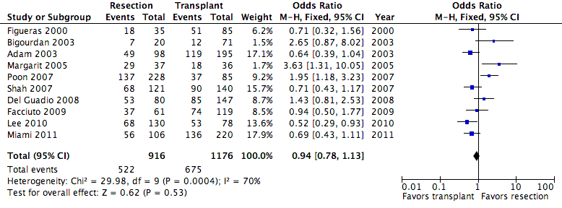
5-Year Overall Survival
Rahman, Pedroso, Sola and Koniaris

Slide 17
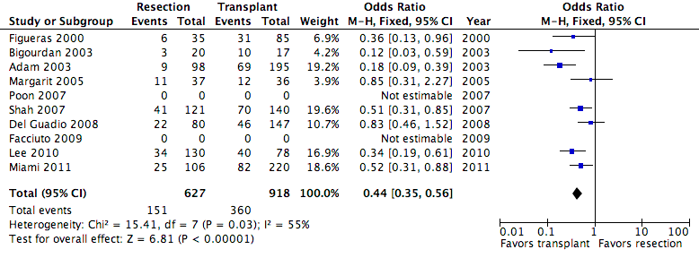
5-Year Disease-Free Survival
Rahman, Pedroso, Sola and Koniaris
Notes:
Among the patients who had 5 year overall survival, the patients in the resection group were less likely to have 5-year Disease-Free Survival (DFS) than the patients in the Transplant group (p=0.000).

Slide 18
University of Miami Review
Our Objective:
Determine relative efficacy of resection or transplantation in the treatment of patients with HCC
Included listed but not-transplanted, and excluded incidentally identified HCCs
Identify patient subgroups that might be better treated with specific therapies
Koniaris, Ann Surg

Slide 19
Resection and Transplant Cohort
Total Patients in Study
(413)
Resection (106)
4 -Later Transplanted
Intent to Transplant
(257)
Transplant Incidentals
(50)
Transplanted
(220)
Listed Not Transplanted (37)

Slide 20
Resection and Transplant Cohort
Total Patients in Study
(413)
X
Resection (106)
4 -Later Transplanted
Intent to Transplant
(257)
Transplant Incidentals
(50)
Transplanted
(220)
Listed Not Transplanted (37)

Slide 21
Patient characteristics:
Resection Patients: Normal liver: (No Cirrhosis/Fibrosis or MELD < 8) = 28 %
Resection Patients: 55% underwent partial lobectomy, 45% formal or extended lobectomy
Resection Patients: Resections were generally performed within 1 month of referral
Median time to transplant 48 days from listing
Similar median age 58, 70% men, some similar tumor characteristics (grade, vascular invasion)

Slide 22
Significant differences:
Hepatitis C in 28% in resection group and 74% of transplant group
Median radiologic tumor size: 7 cm in resection group and 3 cm in transplantation group
Multiple tumors: 15% in resection group and 48% in transplantation group

Slide 23
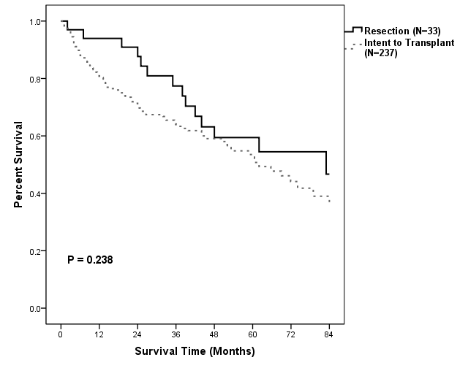
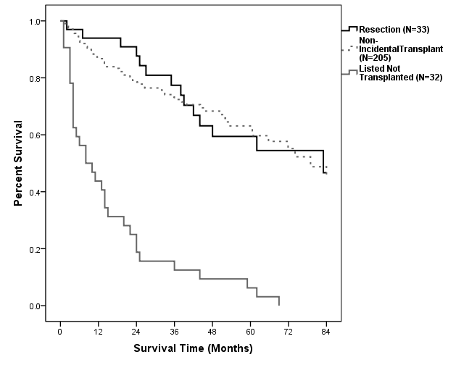
Overall Outcomes:
(All Patients Satisfying Current UNOS Criteria (Milan Criteria)

Slide 24
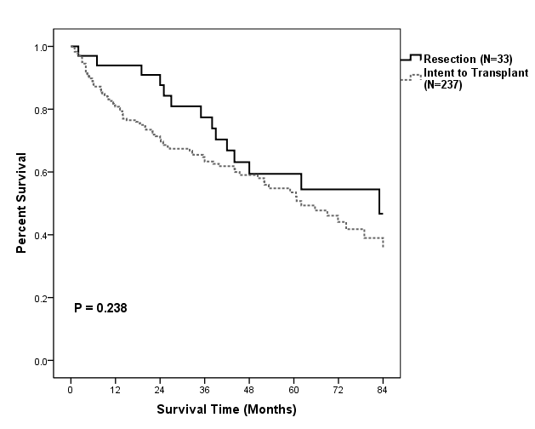
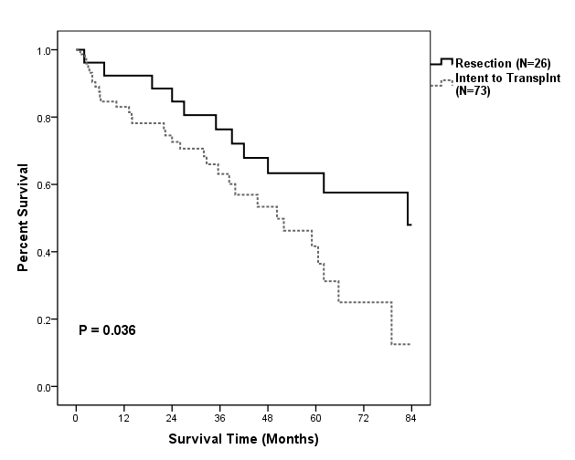
Resection versus ITT within Milan Criteria
Milan Criteria
Milan Criteria, MELD < 10

Slide 25
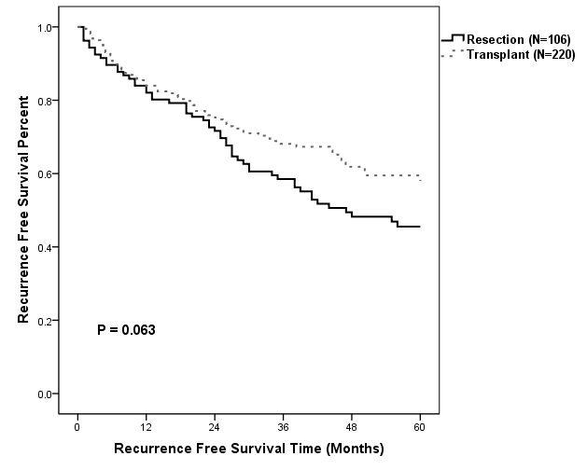
Recurrence-free survival:
(Resection vs. All Non-Incidental Transplants)

Slide 26
Limitations:
Retrospective analysis
More Hepatitis C in transplantation group
More multifocal tumors in the transplantation group
Larger tumors in resection group
Follow-up for recurrence not as stringent in resection cohort

Slide 27
Conclusions:
Many patients are not candidates for both resection and transplantation
Hepatic resection and transplantation have similar overall 5-year survival rates
LT provides greater 5-year DFS overall but may have worse interim survival
Patients listed but not transplanted have a very poor prognosis

Slide 28
Conclusions cont:
For MELD score under 10, improved survival with resection patients relative to patients listed for LT
These data support resection as first line therapy for HCC in early cirrhotics
As the listed-but-not transplanted fraction increases the relative benefit of hepatic resection likely increases versus transplant

Slide 29
Other Perspectives
Optimal approach still controversial

Slide 30
Salvage Transplantation (SLT)
Resected 67 transplant eligible patients
36/67 recurred
Transplanted 16/36 (44%)
5 Year survival - 70%
Saves scarce liver grafts
Cherqui, Ann Surg

Slide 31
“De Principe” SLT
Use liver resection to select patients at high risk for recurrence
Examine pathology for microvascular invasion, satellite nodules, etc.
Transplant high risk patients
Minimizes use of scarce liver grafts
Barcelona Group, Liver Transplantation

Slide 32
Benefit of Salvage Transplantation (SLT)
93 patients: 20 had been resected vs 73 primary LT
6/20 de principe SLT, 14/20 for recurrence
5 Year survival rates: 55% SLT vs 66% for primary LT (NS diff)
Scatton, Liver Transplantation

Slide 33
Single HCC - Resection vs. Tx: Impact of
Size & Short Wait Times
Followed patients 10 years
Recurrences > in Rx group
Rx very early HCC < 2 cm did as well as initial Tx
If < 2 cm recurred, 25% had salvage Tx - 10 year survival of 50%
Rx treatment of choice in very early HCC
Sapisochin (Barcelona), Ann Surg Onc

Slide 34
Is LT Appropriate for Child’s A Milan Criteria HCC?
Child’s A cirrhotics with HCC within Milan criteria got artificially high MELD scores (until 2017)
Goal: estimate survival benefit of deceased donor LT in these patients vs. resection or RFA
Ioannou, Am J Transplantation 2012

Slide 35
Is LT Appropriate for Child’s A Milan Criteria HCC?
Studied 36,791 LT in MELD era: -10,942 had HCC (76% Child’s A or B)
- non HCC recipients (71% Child’s C)
Ioannou, Am J Transplantation 2012

Slide 36
Is LT Appropriate for Child’s A Milan Criteria HCC?
Estimated median survival benefit of LT vs. resection was only 0.7 months at 3 years and 2.8 months at 5 years
5 Year LT survival in Child’s A patients with HCC (68%) worse than non HCC (80%)
Ioannou, Am J Transplantation 2012

Slide 37
Is LT Appropriate for Child’s A Milan Criteria HCC? Conclusions
Although LT may be best treatment for a patient with Child’s A cirrhosis and early HCC, it is probably not the optimal use of scarce organs
Consider using organs in other high MELD non HCC patients where survival benefit much better
Ioannou, Am J Transplantation 2012

Slide 38
Early and Resectable HCC: Who can Avoid Transplantation
357 HCC- Rx=221, Tx=136
Identified good prognosis (GP) group: solitary, <5cm, mod. differentiated, no LVI
Rx=Tx OS at 5 years- 80%
Confirmed by external validation group of 565 pts
Conclusion: primarily resect GP HCC when both feasible
Scatton (Paris), J Surg Onc

Slide 39
Child’s A HCC: Matched Rx vs Tx based on ITT
57 patients each group:
16/57 in Tx group not Tx due to tumor progression
Considering ITT, 5 yr OS not different between 2 groups
Rx viable treatment in resectable Child’s A
Foltys (Germany), Clin Transplant

Slide 40
Resection vs. Tx: Impact of MELD Score & Short Wait Times
Not matched or randomized
Tx- all within Milan criteria- MELD scores
Rx- only 45/126 within MC
Rx bigger and more poorly diff.
Median time to Tx- 55 days- no drop offs
Squires (Atlanta), J Surg Onc

Slide 41
Resection vs. Tx: Impact of
MELD Score & Short Wait Times
Results
All Tx vs Rx: OS 65.7% vs 44%
Tx vs Rx within Milan criteria and MELD < 10: -no significant difference
Short wait times solves ITT issue, with TX >OS and RFS - caveat
Rx Child’s A patients?
Squires (Atlanta), J Surg Onc

Slide 42
Resection vs. Tx when both Feasible:
Impact of MELD Score & MVI
1106 cirrhotics with HCC resected compared to “predicted” survival after Tx
With Rx, 5 Yr survival 67% with MELD <10- Rx benefit vs Tx of 4.5 months
If MELD >10 and no MVI, Tx survival benefit 3 mths
Vitale (Padua & Taipei), Ann Surg Onc

Slide 43
Resection vs. Tx when both Feasible:
Impact of MELD Score & MVI
Conclusions
Tx deleterious in resectable HCC if MELD <10 or with MVI
With organ shortage only a select group of resectable patients with MELD> 10 should be transplanted
Tx if MELD >10 and low risk of MVI
Vitale (Padua & Taipei), Ann Surg Onc

Slide 44
Resection vs. LTx when both Feasible
Metaanalysis
No RCT- if ignore ITT, LTx has better OS and DFS
7 studies- 1572 patients - ITT
No OS advantage at 5 years
Conclusion: primarily resect HCC when both feasible
Proneth, Ann Surg Onc

Slide 45
Cost Benefit Analysis Rx vs. LTx for early HCC
USA, Swiss, Singapore
Willingness-to- pay threshold: $50K/QALY (quality adjusted life year)
Rx 3.9 QALY vs 5.3 for LTx
LT cost effectiveness exceeded threshold in all 3 countries - LTx would have to cost < $73K
Resection is more cost effective
Lim, Hepatology

Slide 46
Does Living Donor Transplantation Change the Dynamic?
It eliminates the intention to treat issue and de-listing dropouts

Slide 47
Living Donor Tx vs Resection when both Feasible (Hong Kong)
Single tumor up to 8cm
50 LDLT vs 300 resections (LR)
OS @ 5/10 yrs: 89 vs 76%, 83 vs 56%
DFS @ 5/10 yrs: 87 vs 57%, 81 vs 40%
Better survival: greater costs, complications, and risks to donor
Dai, HPB

Slide 48
Living Donor Tx vs Rx Child A
Multiple Nodules in Milan Criteria
2-3 nodules <3cm-most hep B
OS @ 5 yrs: 76 vs 51%
DFS @ 5 yrs: 72 vs 20%
Bilobar disease: outcomes same with LDLT but much worse after resection
Consider LDLT with multiple nodules?
Jiang, West China Hospital Transpl Int

Slide 49
Surgical Algorithm Operable Patients
University of Miami
Noncirrhotic - Resection
Cirrhotics - Stratify
1. Child A Small - RX vs TX Large- RX
2. Child B OR C - TX within Milan Criteria

Slide 50
Early Cirrhotics
Resection
Readily available
Cheaper immediate and long term
Results with small tumors?
Peripheral location
Large tumors
Persistent underlying disease
Results - OS vs DFS?

Slide 51
Early Cirrhotics
Transplantation
Gold standard for results but not organ utilization
Treats underlying disease
Less available/more expensive
Inadequate donors
Delisting phenomenon
Recurrence hep C now less problematic

Slide 52
Conclusions
Resection and liver transplantation are complementary therapeutic modalities
Penalty for Rx: recurrence, underlying disease
Penalty for Tx: immunosuppresion, cost, organ availability

